Slide 1
MAE 4733 Project: Ultrasonic RADAR
Alexandre Baillargeon

Slide 2
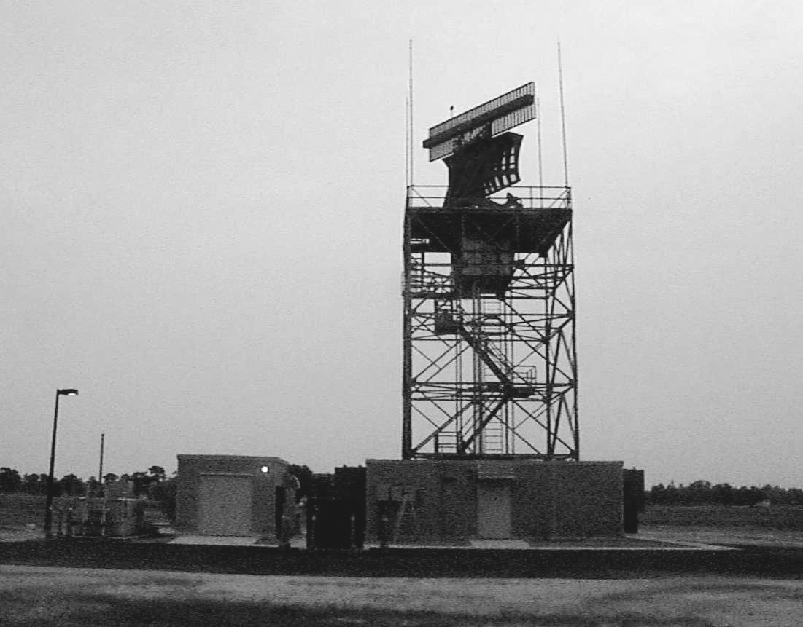
Project Idea
Radar uses radio waves emitted by a rotating dish to determine distance to objects
Sound waves are used for underwater distance measurements (SONAR)
I plan to use ultrasonic waves on a rotating platform to “see” objects

Slide 3
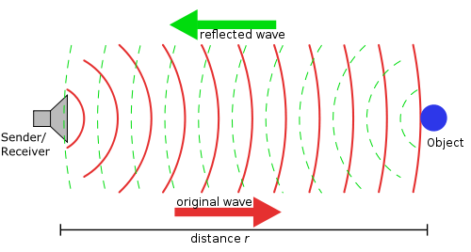
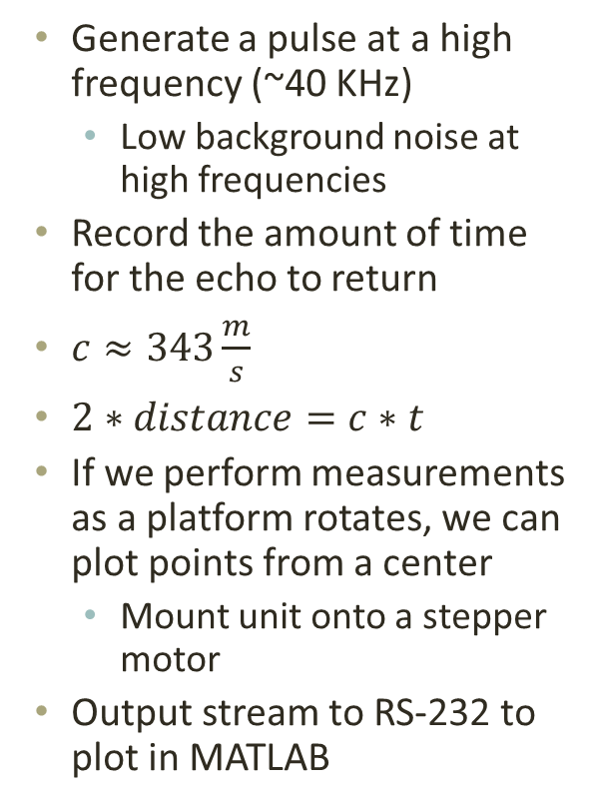
Design
Generate a pulse at a high frequency (~40 KHz)
Low background noise at high frequencies
Record the amount of time for the echo to return
$c≈343\frac{m}{s}$
$2∗distance=c∗t$
If we perform measurements as a platform rotates, we can plot points from a center
Mount unit onto a stepper motor
Output stream to RS-232 to plot in MATLAB

Slide 4
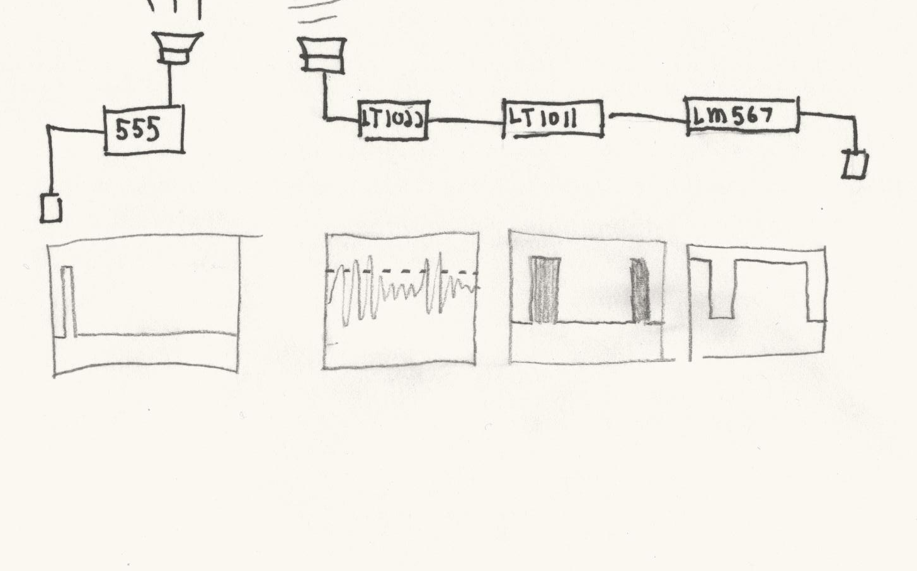
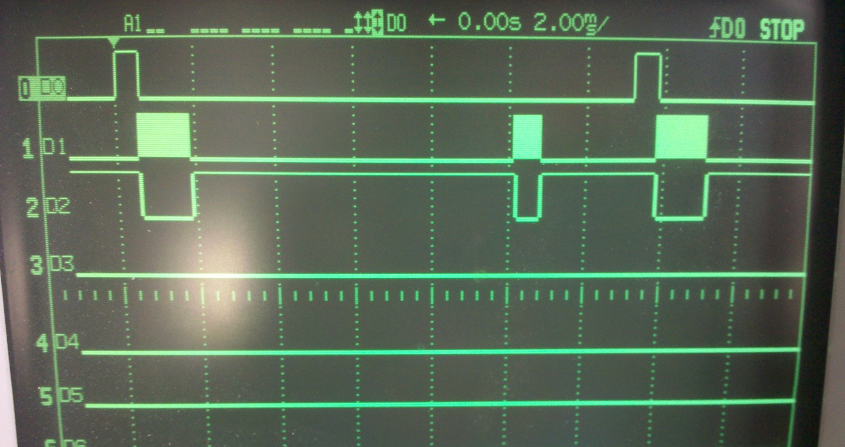
Hardware Design
Output High - Generate and send 40 KHz pulse
Receive/ Amplify return signal
Trigger high at 40 KHz if above threshold
2 Pulses: Feedback and echo
Decode
Pull pin low if 40 KHz signal present
Output Pulse
Amplify
Compare
Decode (Outputs to PIC)

Slide 5
Hardware Selection
Shopping List | Price
Ultrasonic Transmitter/Receiver | $7.95
555 Timer + 2N2222 | $0.13 + $0.04
LM567 Tone Decoder | $0.35
LM7805 5V Regulator | $0.18
L293NE H Bridge | $2.50
Protoboard | $0.80
LT1022 JFET Op Amp | Sampled
LT1011 Comparator | Sampled
8 MHz Crystal | N/A (Old PCB)
MAX232A Line Driver | N/A
200 Step/rev Stepper | N/A
Pic 18F4520 | Sampled
Total | ~$11.95 + small components
555 Timer
to generate 40 KHz signal
Drives 2N2222 transistor
LT 1022
High speed op-amp
LT 1011
General purpose comparator
L293
Stepper motor control
8 MHz crystal
Used 4x PLL to clock pic at 32 MHz
MAX232
Makeshift serial cable to return values to PC

Slide 6
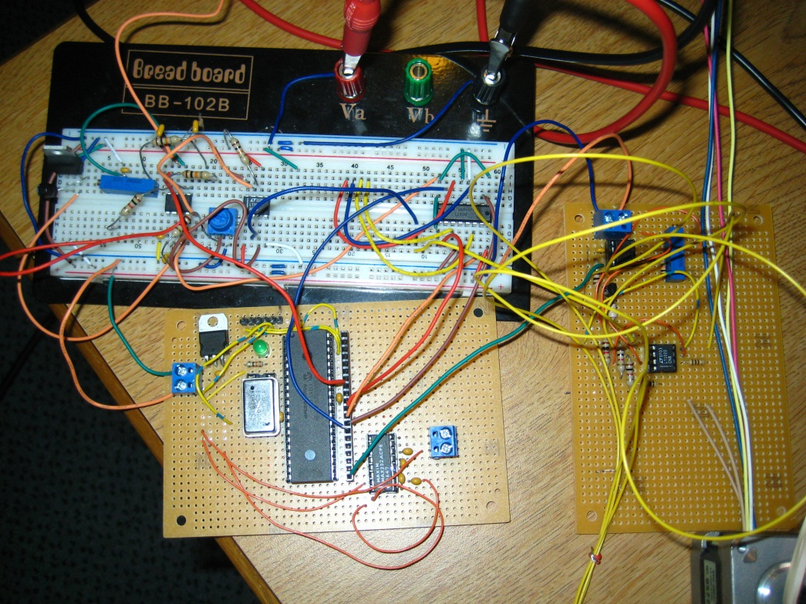
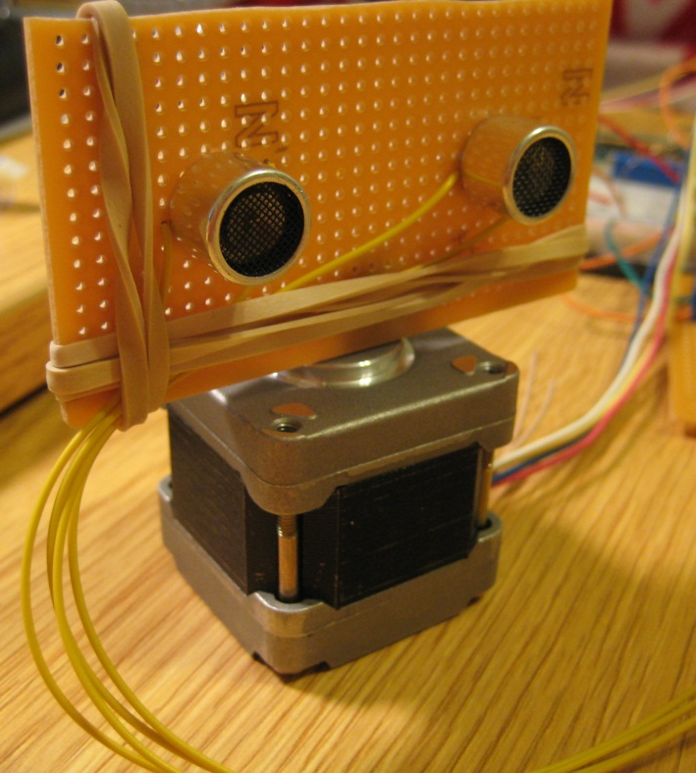
Hardware Setup

Slide 7
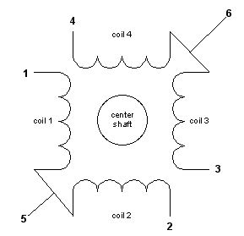
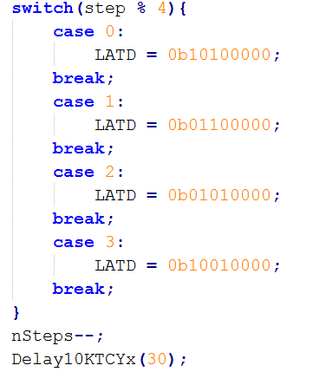
Motor Control
x
Stepper Motors
Unipolar – 6 wires
Bipolar – 4 wires
H-Bridge
Lets us control each wire using 1 pin
Draws current from Vcc, not the pic
Delay 300,000 instructions between each step
About 8 rpm
x

Slide 8
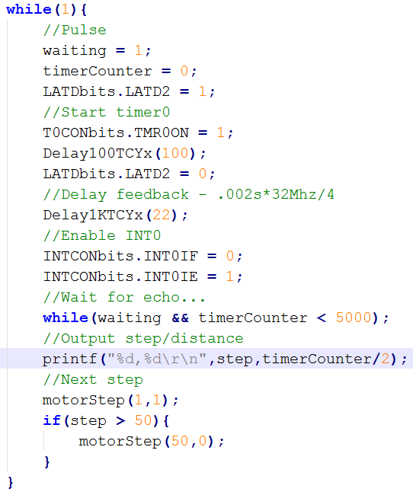
Software Design
Used MPLAB with free academic C compiler
Does not have time-based delays
Take advantage of 32 MHz using 8 bit timer
Overflow every 29μs = 1cm in air
INT0 falling edge stops while loop and prints to RS 232
Start Pulse
Start Timer
Stop Pulse
Enable External Interrupt
Waiting = 0

Slide 9
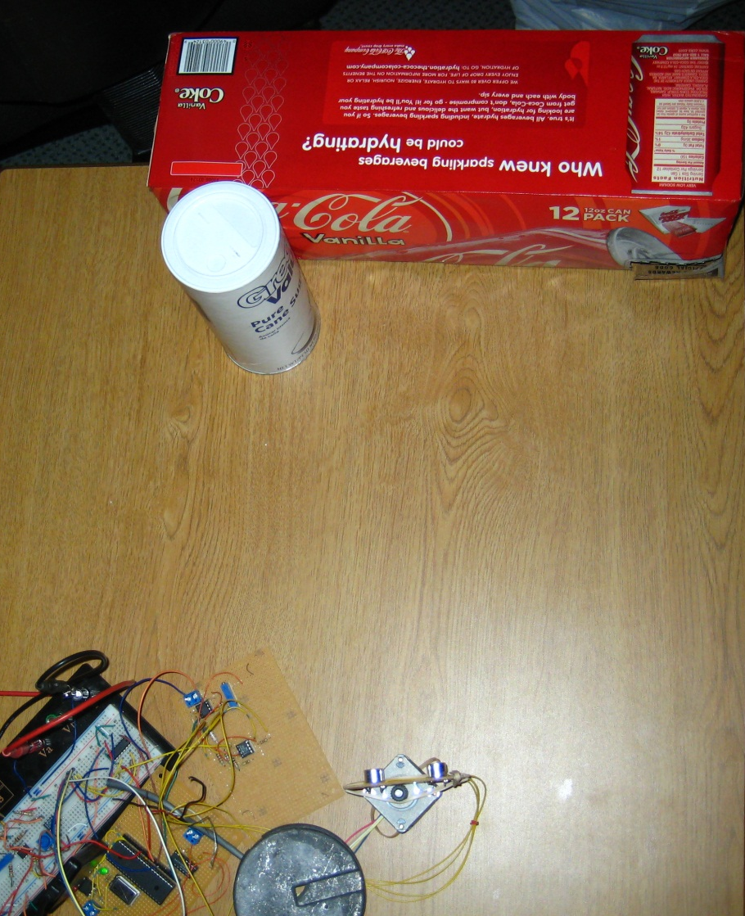
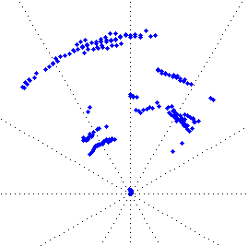
Results
90 degree sweep
Close to minimum 1ft distance
At close range, sensitive to “side echos”
MATLAB script
Reads values [step,dist]
plots step angle vs. distance in polar coordinates

Slide 10
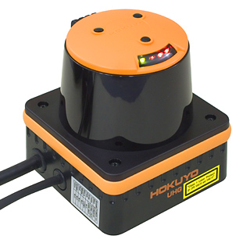
Applications
Autonomous obstacle avoidance
Lawn mowers, Roombas, etc
Automated building maps
Robot “explores” new areas
High tech robots use rotating lasers instead of ultrasonic
Time-of-flight method is more complicated
Sub-mm accuracy, no echo problems
Costs about $4,000

Slide 11
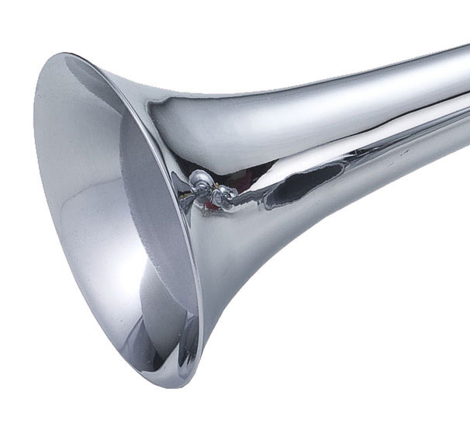
Further Development
Develop a “home” switch for stepper
Motor starts in wrong position
Cone/Horn for transducer
Sound beam is ~ 50 deg wide and picks up too many “side” echos
Fine tune receiving circuit
Balance between sensitivity and false triggering
Second op-amp stage would help
Improve software
Algorithms to throw out false triggers

Slide 12
Lessons Learned
How to use datasheets
Application notes for ICs
MPLAB uses 18F4520 registers for everything (i.e. RCONbits.IPEN to enable priority interrupts)
Interrupts and timers
PIC has 2 priorities of interrupts
Frees up processing power
Stepper Motors
Troubleshooting
Can’t just printf to see what is happening
Really hard without an oscilloscope

Slide 13
Acknowledgements
Linear Technology, Microchip for providing ICs
Siemens AG for letting me use oscilloscope and Pickit 2 programmer
Dr. Young, Chris for mechatronics lab help
Questions?

